Slide 1

Kasten K10
#1 Kubernetes Backup
Michael Courcy
Solution Architect

Slide 2
OCP-V Demo

Slide 3
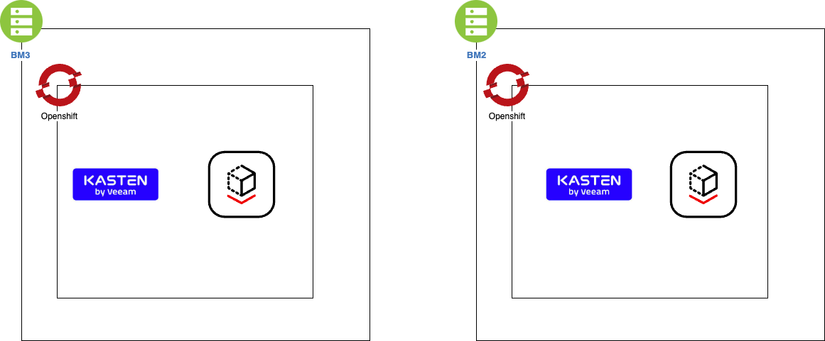
Environment
OCP 4.11.26 OCP-V 4.11.4 ODF 4.11.9 (rhceph 5) Kasten 6.0.3

Slide 4
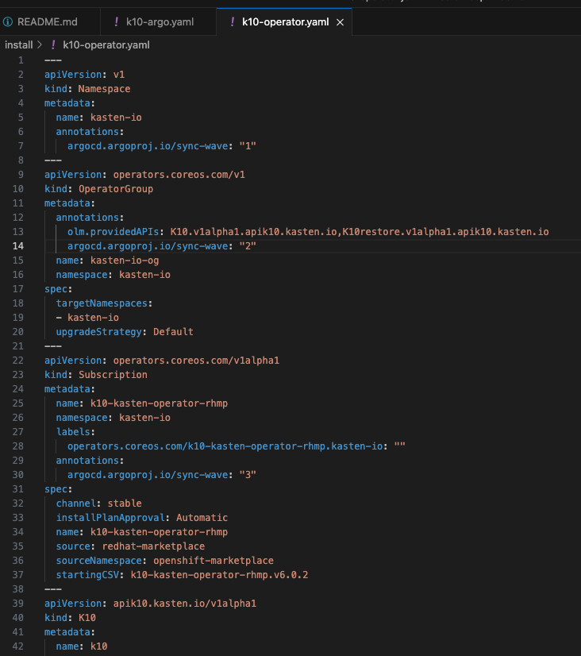
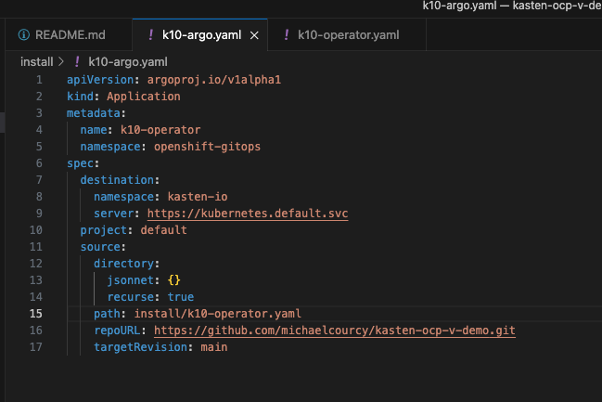
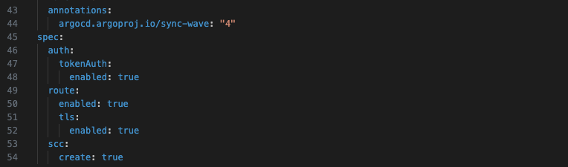
Installation
ArgoCD && Kasten Operator

Slide 5
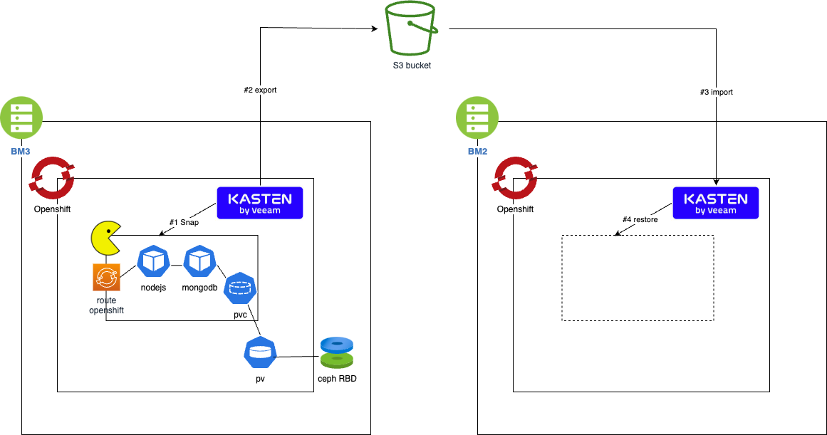
First demo
Classic migration

Slide 6















Kasten K10 Architecture
Purpose-built with no lock-in
1
Orchestrator APIs
Uses Kubernetes API to discover applications and underlying components and perform lifecycle operations.
Infrastructure APIs
No proprietary storage layer. Integration with infrastructure specific APIs for the following:
Block storage provider - Snapshot functionality, snapshot and block copy
Object/file provider - S3-compatible object store or other file storage like NFS for artifacts
Application Framework
Optional agentless application-centric hooks can be invoked by easy-to-use blueprints
Kasten K10 Protected Applications
Application
Blueprint
Application
Blueprint
2
3
3
Cloud Native App
Cloud Native App
Lift-and-Shift App
Lift-and-Shift App
Cloud Native App
Cloud Native App
Cloud Native App
Cloud Native App
1
Container Orchestration Platform
2
3
Virtual or Physical Infrastructure

Slide 7
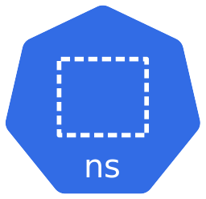

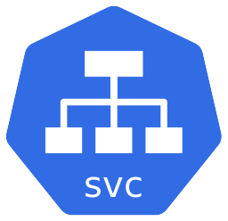


Lock, Flush, and Snapshot
Best of Both Worlds
Before creating snapshot, call data service utility to lock & flush data to disk (e.g. fsyncLock())
Create PVC snapshot via CSI or direct storage integration API
After creating snapshot, release data service lock (e.g. fsyncUnlock())
Backup is ”app consistent” and incremental
Not every data service supports these primitives
PersistentVolume
Claim(s)
PersistentVolume
Claim(s)
backupPrehook
fsyncLock()
Snapshot
PV(s)
backupPosthook
fsyncUnlock()
{
}
{Spec}
{
}
Spec
RestorePoint
Spec
Application Snapshot
Application Restore

Slide 8
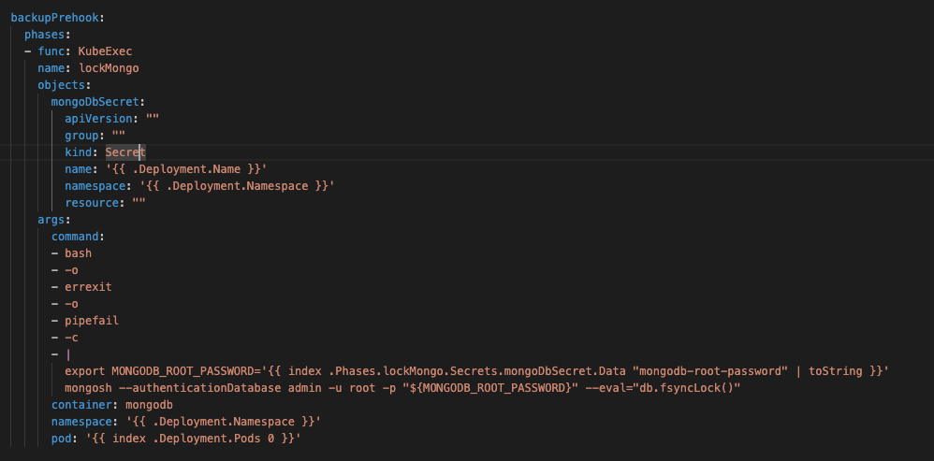
The blueprint
Pre and Post hook

Slide 9
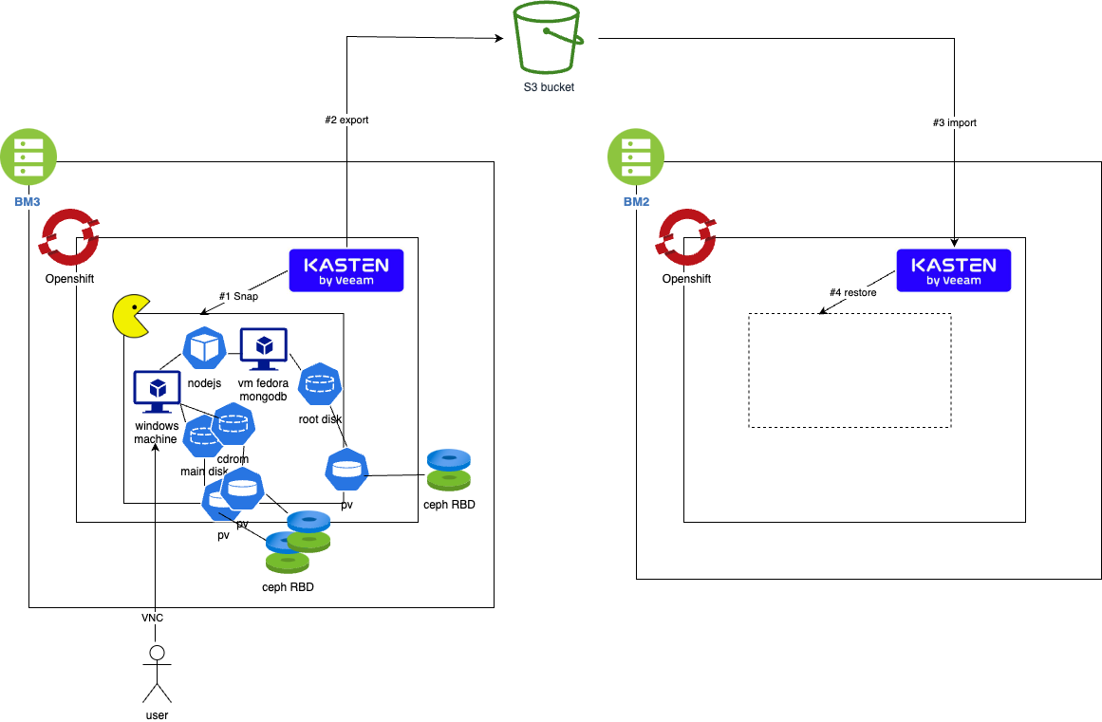
Second demo
VM Migration

Slide 10
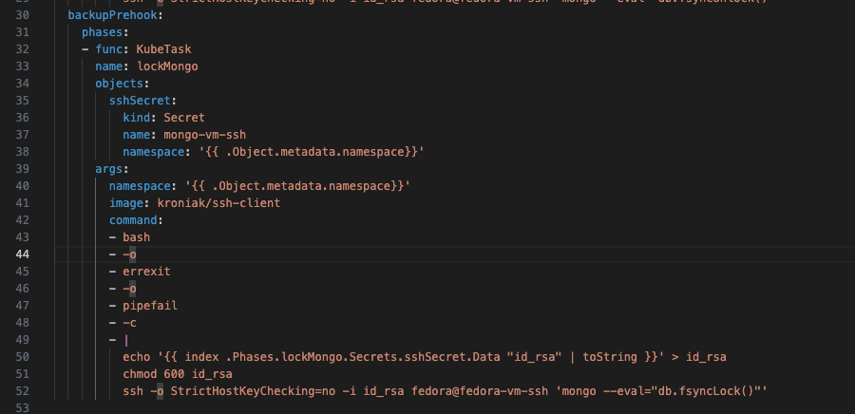
The blueprint
Pre and Post hook with ssh for VM

Slide 11
Thank You!

